Slide 1
Welcome!
We're so happy you could join us today! A few things you can do while we are waiting to get started:
Get the files at https://frameshiftconsulting.com/materials/
Rename yourself: click on "Participants," mouse over your name, click on "Rename," and type in the name you want other people in the meeting to use for you. If you like, include your gender pronouns. Example: "Kendall (he/him/his)".
You are welcome to turn off your video, use your favorite virtual background, or show us your pet!

Slide 2
Ally Skills Workshop
Valerie Aurora & Kendall Howse
http://frameshiftconsulting.com/ally-skills-workshop/
CC BY-SA Frame Shift Consulting LLC, Kendall Howse, Dr. Sheila Addison, The Ada Initiative
k

Slide 3
Format of the workshop
20 minute introduction
2 hours group discussion of real-world scenarios
20 minute wrap-up and Q & A
Long breaks every hour, short "move" breaks in between
k

Slide 4
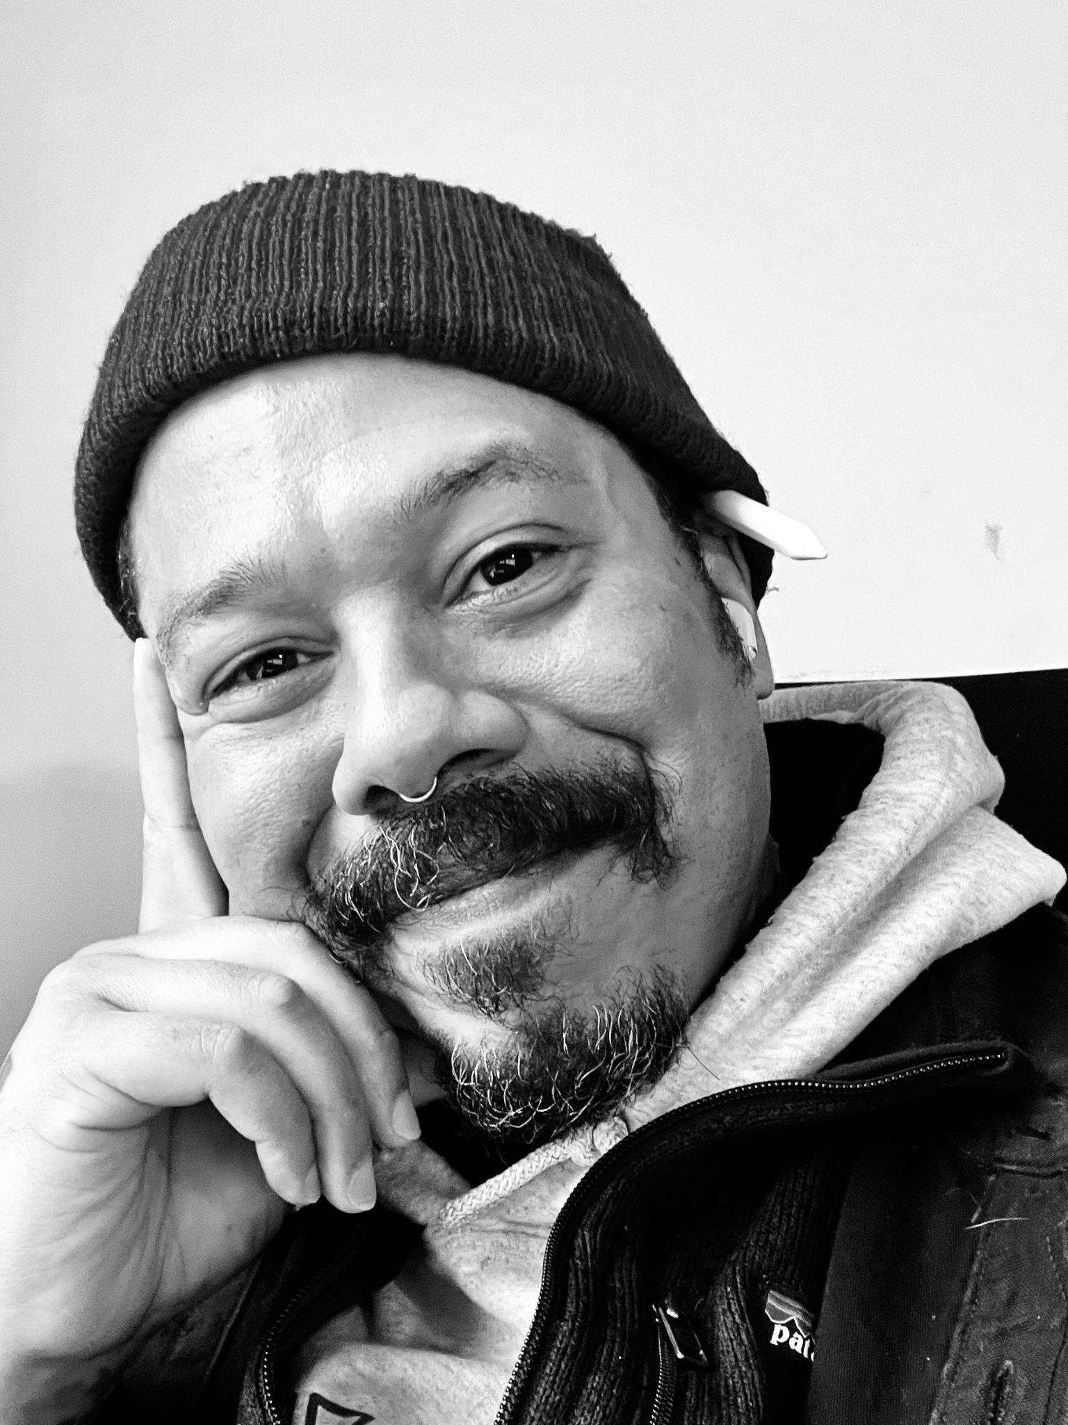
Kendall (Boo Boo) Howse
Award-winning designer, marketing strategist, and DEI leader
30+ years of activism and advocacy, focusing on practical antiracism strategies
Artist, writer, world-touring musician
Kendall Howse
k

Slide 5
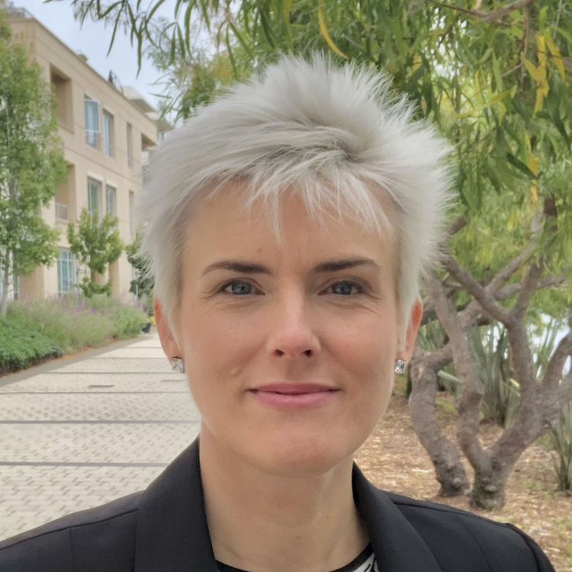
Valerie Aurora
Founder Frame Shift Consulting
Taught ally skills to 4000+ people in Spain, Germany, Australia, Ireland, Sweden, Mexico, New Zealand, UK, and across the U.S.
Software developer in Linux and file systems for 10+ years
Valerie Aurora
v

Slide 6
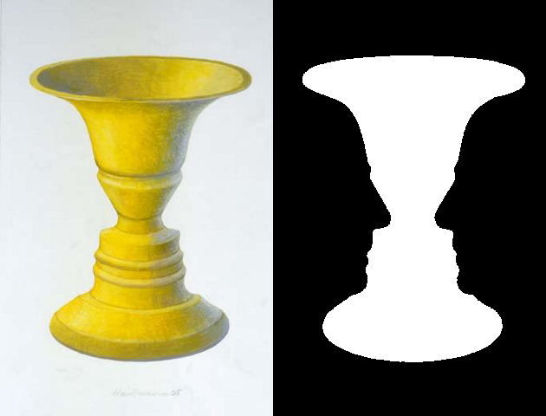
What are ally skills? Some terminology first:
Privilege: an unearned advantage given by society to some people but not all
Oppression: widespread inequality that is present throughout society, that helps people with more privilege and harms those with fewer privileges
v
Notes:
https://commons.wikimedia.org/wiki/File:Rubin2.jpg

Slide 7
More terminology
Marginalized person: a member of a group that is the main target of a system of oppression
Ally: someone that society gives privilege to that is working to end oppression and understand their own privilege
Actions
v

Slide 8
Allyship is an action, not an identity
Being a marginalized person takes no action - oppression just happens to you, no matter what
Being an ally is about what you do, so let's talk about "ally skills" instead of "allies"
Depending on the situation, you may switch between being a marginalized person and being able to take action as an ally
v

Slide 9
Example
Privilege: The ability to walk into a convenience store and have the owner assume you are there to buy things and not steal them
Oppression: The self-reinforcing system of stories, TV, news coverage, police, and legal system stereotyping Black people as criminals, that benefits non-Black people and harms Black people
v
Notes:
Let’s do a quick example. Here’s an example of a privilege some of you may not even realize you have. (Read slide) Note how the ally is defined by their actions.

Slide 10
Example
Marginalized person: Any Black person who wants to enter a convenience store
Ally: A non-Black person who donates to legal system reform organizations, actively objects to racist stories, calls their representatives to support police reform, and reads news articles about this privilege
v
Notes:
Let’s do a quick example. Here’s an example of a privilege some of you may not even realize you have. (Read slide) Note how the ally is defined by their actions.

Slide 11
Why focus on ally skills?
In an experiment, researchers found that when marginalized people work to increase diversity, supervisors give them worse performance evaluations
But when more privileged people work to increase diversity, it does not harm their performance evaluations (and may improve them)
Does valuing diversity result in worse performance ratings for minority and female leaders? http://amj.aom.org/content/early/2016/03/03/amj.2014.0538.abstract
k
Notes:
Marginalized people are more likely to suffer retaliation when they speak out against oppression. This great study from 2016 looked at what happened to men vs. women and people of color vs white people when they did what they called "engage in diversity-valuing behavior." Listen to this quote: (Read slide)

Slide 12

Let's focus on ally skills
For this workshop, let's assume that oppression exists, it's bad, we should try to stop it, it's possible to stop, etc.
Disagree? No problem, just argue about it somewhere else
We can't give legal advice or tell you what your employer's rules are
CC BY-SA Todd Chandler
https://flic.kr/p/gqhYR2
k

Slide 13
Exercise: Identify your power and privilege
Privilege and power are often invisible to people who have them, but identifying them helps you act as an ally
This exercise is voluntary - you do not have to do it
If people assume you have a privilege that you do not, you can make your own decision about whether to include it
Download at https://frameshiftconsulting.com/materials/
k
Notes:
https://incompetech.filmmusic.io/song/3499-chill/

Slide 14
What did you think?
Do you have more or less power than you thought?
Do you have more or less privilege than you thought?
Any surprises or things you hadn't thought about before?
https://flic.kr/p/H2cL7F
CC BY-SA jason gessner
k

Slide 15
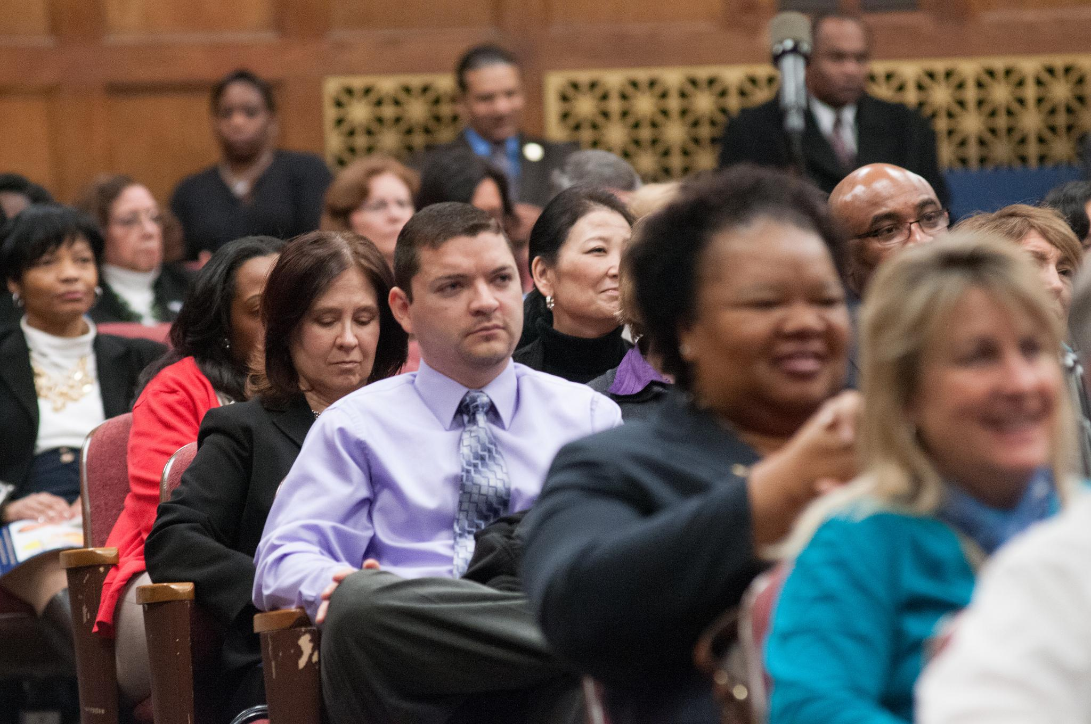
Basics of ally skills
Be short, simple, firm
Don't try to be funny
Play for the audience
Practice simple responses
Pick your battles
v
Notes:
Public domain https://flic.kr/p/e52K1T

Slide 16
While you're trying to help one group, don't be:
✖ sexist
✖ homophobic
✖ transphobic
✖ racist
✖ ableist
✖ ageist
✖ classist
✖ casteist
… and don't criticize people's bodies or attractiveness
v

Slide 17
What if I make a minor mistake?
Acknowledge, apologize,
and move on.
k

Slide 18
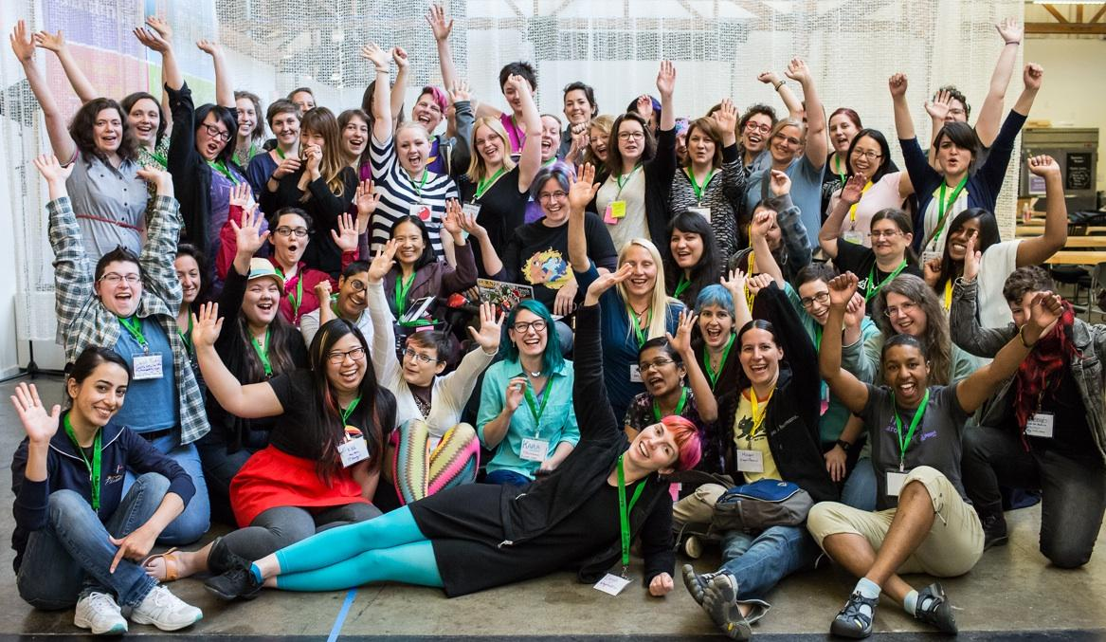
One of Valerie's mistakes: "You guys"
CC BY-SA Jenna St Martin photo
v

Slide 19
Help us create a safer space
You may leave or return at any time without explanation
This workshop is designed to be voluntary
You only have to share if you feel comfortable doing so
Please anonymize stories if you can
Joining groups is optional
Tell us if you should not be in a group with someone
v

Slide 20
Preparing for group discussion
Each group will choose a note-taker and moderator
Moderator interrupts people who are speaking too much and invite others to speak
Feel free to moderate the moderator! 🙂
Note-taker writes a short summary of what you talked about and copies it into group chat on return
Do not volunteer to be note-taker more than once!
v

Slide 21
A few more tips for group discussion
There aren't any misleading scenarios
"You" in the scenario means "a potential ally"
Focus on what an ally can do
If necessary, make up additional details
When you get the 1 minute warning, keep talking!
Note-taker: don't use the breakout group chat for notes
v

Slide 22
Scenarios & group discussion

Slide 23
Scenario: What could an ally do?
At a meeting, a woman makes a suggestion, but no one picks up on it. Later on in the meeting, a man makes the same suggestion and is given credit for it.
Remember, choose your notetaker and moderator!

Slide 24
Tip: Effective and just meetings have structure
Meetings without explicit structure inherit structure from society, reinforcing systems of oppression
Use structure to fight oppression: agenda, meeting roles, reserved speaking time, hand signals, etc.
Useful meeting roles: facilitator, moderator, note-taker, timekeeper
https://frameshiftconsulting.com/meeting-skills/

Slide 25
Who is speaking in your group?
Who is speaking most in your group?
Is someone having difficulty being heard?
Are there patterns related to gender, race, age, or anything else?
How do these discussions compare to ones you have in other contexts?

Slide 26
Long break

Slide 27
Scenario: What could an ally do?
You are in a meeting about hiring more people from a marginalized racial group into positions of power. A colleague of yours says, "It's great to hire more people from this group, but let's not lower the bar." Before you can reply, another colleague says, "Oh yes, we'll be careful not to lower the bar."

Slide 28
Tip: Reframe the discussion
Assumption: at present, everyone has an equal chance of being hired, regardless of race
Reality: Racialized people face a much a higher bar than members of the dominant race, who often get a pass or exceptions to the process
Reframe: "Actually, the problem is that people in this group have to pass a higher bar, and we need to fix that."

Slide 29
Short break

Slide 30
Scenario: What could an ally do?
Several of your coworkers loudly praise others when they take the stairs. They also want to start a office-wide challenge to take a certain number of steps daily.

Slide 31
Tip: Keep fitness talk consensual
People with mobility impairment may not be able to take the stairs or walk any steps, much less thousands per day
People should only comment on other people's fitness or health decisions when everyone present wants to hear it
Most workplace wellness challenges are ableist in some way (and also don't have the desired effect)

Slide 32
Long break

Slide 33
Scenario: What could an ally do?
One of your direct reports avoids speaking to another of your direct reports. When you ask, they say it is because that person is gay and homosexuality is against their religion and not acceptable where they grew up. When you push back, they say that you should be more considerate of people from other cultures.

Slide 34
Tip: "Paradox" of tolerance
https://en.wikipedia.org/wiki/Paradox_of_tolerance
A tolerant society must be intolerant of one thing: intolerance itself (otherwise intolerance takes over)
Multiculturalism is good but you should leave out the parts that dehumanize people based on identity
Company culture takes precedence in this case

Slide 35
Short break

Slide 36
Scenario: What could an ally do?
A co-worker comes out as trans. Another co-worker assumes you are cis and starts complaining to you privately about how ridiculous it is to expect everyone to start using your co-worker’s new name and pronouns.

Slide 37
Tip: Read Captain Awkward
Advice blog that answers questions on social interaction with specific suggested scripts and detailed explanations
Great for "How do I get someone to stop doing something without upsetting anyone?" type of questions (hint: someone is already upset)
http://captainawkward.com

Slide 38
Goal-setting exercise
Start planning how to use ally skills in your life!
Download the goal-setting exercise: https://frameshiftconsulting.com/#materials
Spend 5 minutes filling it out
Type "done" in chat when you are done

Slide 39
Advanced ally skills
Speak less, listen more - except when speaking is risky
Treat ally actions as bare minimum expectation
Follow and support leaders from marginalized groups
Understand your discomfort before reacting
Avoid "sensitivity gotcha" and encourage growth mindset
Made a mistake? Acknowledge, apologize, and move on

Slide 40
Ally Skills Workshop
http://frameshiftconsulting.com/ally-skills-workshop
Frame Shift Consulting

Slide 41
Alternate intro slides

Slide 42
Example
Privilege: The ability to walk into a convenience store and have the owner assume you are there to buy things and not steal them
Oppression: The self-reinforcing system of stories, TV, news coverage, police, and legal system stereotyping Black people as criminals, that benefits non-Black people and harms Black people
Notes:
Let’s do a quick example. Here’s an example of a privilege some of you may not even realize you have. (Read slide) Note how the ally is defined by their actions.

Slide 43
Example
Marginalized person: Any Black person who wants to enter a convenience store
Ally: A non-Black person who donates to legal system reform organizations, actively objects to racist stories, calls their representatives to support police reform, and reads news articles about this privilege
Notes:
Let’s do a quick example. Here’s an example of a privilege some of you may not even realize you have. (Read slide) Note how the ally is defined by their actions.

Slide 44
Can I act as an ally when clients misbehave?
Depends on the power distribution
Can they easily fire you and get the same benefits?
Can you easily fire them and get replacement business?
Ally skills only work from a position of power
https://dearally.com/2019/05/14/6-what-do-i-do-about-oppressive-speech-from-clients/

Slide 45
Other scenarios

Slide 46
Scenario: What could an ally do?
In meetings, you notice that both clients and your coworkers tend to speak more to older and/or more tenured coworkers, even when responding to question or comment from a younger and/or newer coworker.

Slide 47
Tip: Redirect the conversation
"I'm not sure. [NAME], what do you think?"
"You know who the expert on that is, [NAME]! [NAME], can you answer that?"
"[NAME] could probably give you a better answer than I can. [NAME], is this something you know?"
"I'd like to hear from [NAME] because they always bring a new perspective. [NAME], any thoughts?"

Slide 48
Scenario: What could an ally do?
A woman in your company goes on maternity leave. You are discussing which projects to assign to people after she has returned, including one that is in her area of expertise and requires some travel. A co-worker says, "She has a small baby, I'm guessing she won't want to travel."

Slide 49

Tip: What Works for Women at Work
By Joan C. Williams and Rachel Dempsey
Four patterns of subtle bias, varying by race, ethnicity, appearance, etc.
Prove-it-again
The Tightrope
The Maternal Wall
Tug-of-war

Slide 50
Scenario: What could an ally do?
Whenever the topic of sexism comes up, a male colleague says, "I do my part. I always insist on walking women to their cars after dark. And I put a lunch on their calendar to give them my career advice."

Slide 51
Tip: Don't insist on giving unwanted "help"
Offer help in a way that makes it easy to people choose what works best for them because they are the experts
Acting as an ally means reducing the imbalance of power, not reinforcing it
Being a powerful "savior" is rewarding - avoid the lure!
Anti-racism version: "white savior"

Slide 52
Scenario: What could an ally do?
While driving together somewhere, a colleague of yours starts a sentence with "Look, it isn't politically correct to say this, but I'm going to say it anyway—"

Slide 53
Tip: Learn to interrupt, and keep interrupting!
"Let's not make this weird."
"Not this again! I don't want to argue. How was your weekend?"
"I read that political correctness means treating people fairly and respectfully, which is something I'm really into."
"Why do you want to tell me something that you know I won't agree with? Do you want my approval?"

Slide 54
Scenario: What could an ally do?
While talking about an incident of structural racism in the news, a white colleague of yours says proudly, "My parents raised me not to see color."

Slide 55
Tip: Recenter the conversation
"I decided to talk less about how un-racist I am and talk more about how to stop the racism that is happening."
"I heard that 'I don't see color' sounds like 'I don't see people being racist to you' and so I stopped saying it."
"It feels good to feel like I'm not the problem, but now I want to be part of the solution. And that means seeing race so that I notice when unfairness is happening."

Slide 56
Scenario: What could an ally do?
A peer manager tells you that one of their reports has complained about people using the word "Aspie" in a derogatory way. The manager says, "I told them to stop complaining and grow a thicker skin."
Note: "Aspie" is a nickname for Asperger's syndrome, which can be used as a slur.

Slide 57
Tip: Include the context of systemic oppression
Foot-stepping analogy: Why is this person so upset that you accidentally stepped on their foot?
Answer: Because someone steps on their foot TEN TIMES A DAY, EVERY DAY, FOR THEIR ENTIRE LIFE
The person who likes the slur can also "grow a thicker skin," accept this criticism, and change their behavior
https://thebias.com/2017/09/26/how-good-intent-undermines-diversity-and-inclusion/

Slide 58
Scenario: What could an ally do?
In your organization, you notice that the higher up the hierarchy someone is, the more likely they are to be white, male, or otherwise privileged. Three different groups announce a new senior hire in one month. All three appear to be white men.

Slide 59
Tip: Bias interrupters
3 step process from UC Hastings WorkLife Law Center
Use metrics
Implement bias interrupters
Repeat as needed
Detailed list of bias interrupters for workplace systems:
http://biasinterrupters.org/

Slide 60
Scenario: What could an ally do?
You are eating lunch in the employee kitchen when a group sits down near you. One person comments loudly “If I ate that, I’d be as big as a house!” A higher-weight coworker is sitting nearby and can clearly overhear.

Slide 61
Tip: Weight discrimination at work
“Fat talk/diet talk” can be used as a form of bonding but creates a hostile environment
Higher weight people face workplace discrimination, particularly women, regardless of ability to do the job
Body size is falsely equated with virtue: self-control, hard worker, in good health
Workplace “health initiatives” often discriminate against higher weight and disabled employees and don't work
Notes:
Higher weight people are less likely to be hired, less likely to be given responsibility at work, more likely to receive negative performance evaluations, and less likely to be promoted, in addition to experiencing a “pay gap” with lower-weight colleagues
Talk about criticizing employees as “lazy” for taking the elevator

Slide 62
Scenario: What could an ally do?
In a meeting you attend, several people disagree strongly but productively over a technical decision. Later, one of the other people in the meeting tells you they were disturbed by your report's tone in the meeting. Your report was the only person of a marginalized race/ethnicity in the meeting. This has happened many times.

Slide 63
Tip: tone policing/the “tone argument”
When members of marginalized groups advocate for themselves or their ideas, it violates expectations that marginalized people should be submissive and quiet
The same behavior in a person with a lot of privilege may be described as "passionate" or "committed"
Tone policing often uses the word "tone"
https://en.wikipedia.org/wiki/Tone_policing

Slide 64
Scenario: What could an ally do?
A woman on your team has been successfully filling in for her direct superior after he left. After 6 months, she asks to be formally promoted to the position. Instead, your director hires a man from outside the company with less experience to fill the position and asks her to train the new hire. When you ask why, your director tells you that the new hire has a lot of potential.

Slide 65
Tip: What Works for Women at Work
By Joan C. Williams and Rachel Dempsey
Four patterns of subtle bias, varying by race, ethnicity, appearance, etc.
Prove-it-again
The Tightrope
The Maternal Wall
Tug-of-war

Slide 66
Scenario: What could an ally do?
In your weekly team meetings, you notice that women don't speak nearly as often as men. When women do speak, you notice that they are interrupted more often than men.

Slide 67
Tip: Create psychological safety
Psychological safety means an environment in which people feel safe and take turns sharing information
Google study showed the most productive and profitable teams have psychological safety
Two elements: sensitivity to others' feelings, and conversational turn-taking
https://en.wikipedia.org/wiki/Psychological_safety

Slide 68
Tip: How to create psychological safety?
More structure: agenda, moderator, reserved speaking time, hand signals to request speaking time, etc.
Praise and reward when quiet people speak up more
Discourage shaming, humiliation, dominance
Reduce hierarchy (switch up who takes notes, change meeting leader, powerful person gets coffee, etc.)

Slide 69
Scenario: What could an ally do?
A woman of color points out that an upcoming company-wide meeting will have all white male presenters. Several other people criticize their coworker for being too abrasive, aggressive, loud, out of line, etc.

Slide 70
Tip: tone policing/the “tone argument”
When members of marginalized groups advocate for themselves or their ideas, it violates expectations that marginalized people should be submissive and quiet
The same behavior in a person with a lot of privilege may be described as "passionate" or "committed"
Tone policing often uses the word "tone"
https://en.wikipedia.org/wiki/Tone_policing

Slide 71
Scenario: What could an ally do?
In your team's weekly meeting, you notice that the group often ends up agreeing with whatever the loudest, most persistent talker wants to do, even when most people think it is not the best solution.

Slide 72
Tip: Create psychological safety
Psychological safety means an environment in which people take turns sharing information
Google study showed the most productive and profitable teams have psychological safety
Two elements: sensitivity to others' feelings, and conversational turn-taking (equal speaking time)
https://en.wikipedia.org/wiki/Psychological_safety

Slide 73
Scenario: What could an ally do?
On a Slack channel with about 50 people, a co-worker is talking about a badly implemented software feature. They write, "That's so ghetto," followed by a smiling face emoji.

Slide 74
Tip: Have a concise code of conduct with examples
Have a short, clear, concise code of conduct that focuses on what not to do
Specifically list common forms of oppression
Put everything else (values, how to be inclusive, etc.) in separate documents
Hand over any dispute over CoC violations to an expert
https://frameshiftconsulting.com/code-of-conduct-book/

Slide 75
Scenario: What could an ally do?
You are one of the interviewers for a person applying to an operations position. You notice that their resume says they graduated from university 20 years before anyone else on the team. In the hiring discussion, a coworker says, "I worry that they won't be able to keep up with the rest of us."

Slide 76
Tip: Bias interrupters
3 step process from UC Hastings WorkLife Law Center
Use metrics
Implement bias interrupters
Repeat as needed
Detailed list of bias interrupters for workplace systems:
http://biasinterrupters.org/

Slide 77
Scenario: What could an ally do?
In social spaces at work, like work parties and online social chat channels, you notice that men speak far more often than women. When you ask women why they speak less, they note that women generally have less power in your company hierarchy and men with more power strongly influence the topic of conversation.
k

Slide 78
Tip: Be welcoming and redistribute power
People with more power can express interest and encourage follow-up: "That's interesting!" "Tell me more" "Thank you for bringing up that important topic"
Automatic measurement can inform people privately if they are taking up more space than average, or as a group
Giving more power and influence to care and maintenance functions can change the power balance positively

Slide 79
Scenario: What could an ally do?
Your team announces that the next team-building offsite activity will be playing laser tag.

Slide 80
Tip: Inclusive offsites
Design your offsite meetings to be inclusive
Make a list of marginalized groups and spend time researching how each might feel left out
Lists of more inclusive and less inclusive offsites here:
https://geekfeminism.wikia.com/wiki/Inclusive_offsites

Slide 81
Scenario: What could an ally do?
You are part of the performance review process and see a lot of feedback for other employees. The feedback for several women include comments like "Needs to work on her communication style," or "too aggressive." Many fewer men's reviews have the same problems.

Slide 82
Hint: it’s not the women
"When we analyzed a sample of performance evaluations of men and women across three high-tech companies and a professional services firm, we found that women consistently received less feedback tied to business outcomes. [...] 76% of references to being "too aggressive" happened in women’s reviews, versus 24% in men’s."
Shelley Correll and Caroline Simard, https://hbr.org/2016/04/research-vague-feedback-is-holding-women-back

Slide 83
Tip: Bias interrupters
3 step process from UC Hastings WorkLife Law Center
Use metrics
Implement bias interrupters
Repeat as needed
Detailed list of bias interrupters for workplace systems:
http://biasinterrupters.org/

Slide 84
Scenario: What could an ally do?
On a company mailing list, someone writes “How would you explain this [technical thing] to your grandmother?”

Slide 85
Tip: Charles' Rules of Argument
Don't go looking for an argument
State your position once, speaking to the audience
Wait for absurd replies
Reply one more time to correct any misunderstandings of your first statement
Do not reply again
Spend time doing something fun instead
https://hypatia.ca/2014/09/13/charles-rules-of-argument-the-short-version/

Slide 86
Scenario: What could an ally do?
On a company Slack channel, a co-worker responds to a suggestion of yours with, "That's so gay!" and a smiley face emoji.

Slide 87
Tip: Have a concise code of conduct with examples
Have a short, clear, concise code of conduct that focuses on what not to do
Specifically list common forms of oppression
Put everything else (values, how to be inclusive, etc.) in separate documents
Hand over any dispute over CoC violations to an expert
https://frameshiftconsulting.com/code-of-conduct-book/

Slide 88
Scenario: What could an ally do?
When discussing which of two final candidates to make an offer to, a co-worker says, "I know we agreed experience is more important for this position, but the younger candidate has a degree from Stanford, which I think makes them better than the older candidate with ten more years of experience."

Slide 89
Tip: Bias interrupters
3 step process from UC Hastings WorkLife Law Center
Use metrics
Implement bias interrupters
Repeat as needed
Detailed list of bias interrupters for workplace systems:
http://biasinterrupters.org/

